Slide 1
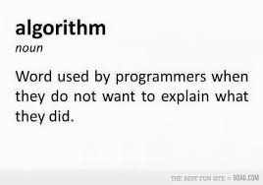

Slide 2
Arrays & Strings

Slide 3
Objective
Understand what an array is
Learn about one-dimensional array, their declaration, initialization, ways to access individual array elements, representation of array elements in memory, and other possible operations
Learn about one-dimensional strings and the way they are declared, initialized, manipulated, inputted, and displayed
Learn about two-dimensional arrays, initialization of sized and unsized two-dimensional
Arrays, accessing elements in such arrays, and how this kind of an array can be used
Know about array of strings, its declaration, initialization, other operations, manipulations, and uses
Get a brief idea of three-dimensional arrays or even larger ones

Slide 4
Introduction
A scalar variable is a single variable whose stored value is an atomic type.
For example, each of the variables ch, n, and price declared in the statements
char ch;
int n;
float price;
Are of different data types and each variable can only store one value of the declared data type. These types of variables are called scalar variables.
This means that the value cannot be further subdivided or separated into a legitimate data type.
An aggregate type, which is referred to as both a structured type and a data structure, is any type whose values can be decomposed and are related by some defined structure.

Slide 5
Key Words
Aggregate data type: It is an agglomeration of data, of any data type, that is identified with a single name and can be decomposed and related by some defined structure.
Array identifier: A name assigned to an array.
Array initialization: The procedure of assigning numerical value or character to each element of an array.
Array of strings: An array that contains strings as its elements.
Array: It is a collection of individual data elements that is ordered, fixed in size and homogeneous.
Concatenation of strings: A kind of string manipulation where one string is appended to another string.

Slide 6
Key words
Homogeneous data: Data of same kind or same data type.
Index of an array: It is an integer constant or variable ranging from 0 to (size – 1).
Library functions: Pre-written functions, provided with the C compiler, which can be attached to user written programs to carry out some task.
Multidimensional array: An array that is represented by a name and more than one index or subscript.
One-dimensional array: An array that is represented by a name and single index or subscript.
Scalar variable: It is a single variable whose stored value is an atomic data type.
Scanset: It is a conversion specifier that allows the programmer to specify the set of characters that are (or are not) acceptable as part of the string.

Slide 7
Key Words
Size of array: The number of elements in an array.
Stderr: The side stream of output characters for errors is called standard- error.
Stdin: Standard input stream that is used to receive and hold input data from standard input device.
Stdout: Standard output stream that is used to hold and transfer output data to standard output device.
String compare: A kind of string manipulation where two strings are compared to primarily find out whether they are similar or not.
String copy: A kind of string manipulation where one string is copied into another.
String manipulation: Carrying out various operations like comparing, appending, copying, etc. among strings.
String : One-dimensional array of characters that contain a NUL at the end.

Slide 8
Why Array?
Consider a brand-new problem: a program that can print its input in reverse order. If there are two or three values, this is easy but what if there are ten or twenty or one hundred values? Then it is not so easy. To avoid above problem we use array .
A scalar variable is a single variable whose stored value is an atomic data type.
An array is a collection of individual data elements that is ordered, fixed in size, and homogeneous.
An array is considered to be a derived data type.
Array enables the storing and manipulation of potentially huge quantities of data.

Slide 10
One-Dimensional Array
There are several forms of an array used in C:
One dimensional or single-dimensional and multidimensional array.
Since the array is one dimensional, there will be a single subscript or index whose value refers to the individual array element which ranges from 0 to (n–1), where n is the total number of elements in the array.
When defining an array in a program three things need to be specified.
The type of data it can hold, i.e., int, char, double, float, etc.
The number of values it can hold, i.e., the maximum number of elements it can hold
A name

Slide 11
One-Dimensional Array
The array size must be a positive integer number or an expression that evaluates to a positive integer number that must be specified at the time of declaration with the exception that it may be unspecified while initializing the array.
In C, the array index starts at 0 and ends at (size–1) and provides the means of accessing and modifying the specific values in the array.
C never checks whether the array index is valid—either at compile time or when the program is running.

Slide 12
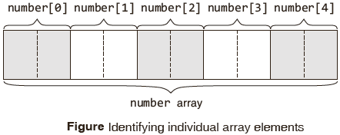
Syntax: Array
The syntax for declaration of a one-dimensional array is data_type array_name [SIZE];
All the array elements hold values of type <data type>
The size of the array is indicated by <SIZE>, the number of elements in the array. <SIZE> must be an int constant or a constant expression.
int a[size]; /* memory space for a[0],a[1],…, a[size –1] allocated */
lower bound = 0
upper bound = size –1
size = upper bound + 1
number[0] & number[4] refers to the first & fifth number stored in the ‘number’ array respectively .

Slide 13
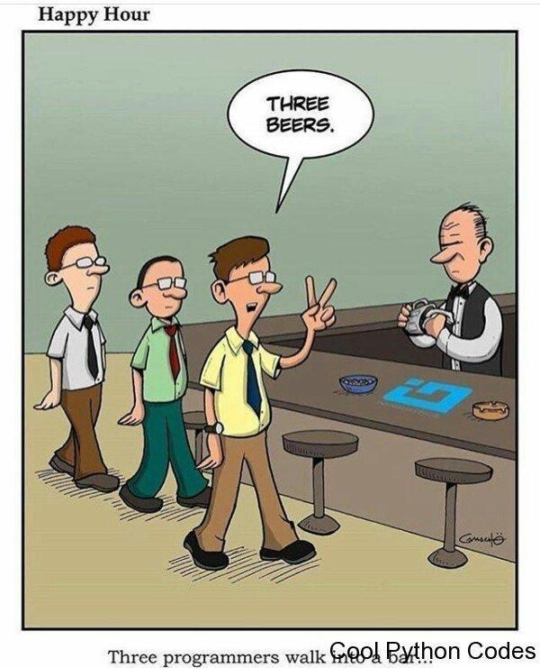

Slide 14
Initializing Integer Arrays
Variables can be assigned values during declaration like the following example.
int x = 7;
Array initialization statements as shown.
(a) int A[10] = {9, 8, 7, 6, 5, 4, 3, 2, 1, 0};
9 8 7 6 5 4 3 2 1 0 ¨ values stored in array elements
0 1 2 3 4 5 6 7 8 9 ¨index values of array elements
(b) double a[5] = {3.67, 1.21, 5.87, 7.45, 9.12}
Automatic sizing While initializing, the size of a one dimensional array can be omitted as shown.
int arr[] = {3,1,5,7,9};
Here, the C compiler will deduce the size of the array from the initialization statement.

Slide 15
Array declaration, initialization and accessing | Example
Array declaration syntax: data_type arr_name [arr_size]; Array initialization syntax: data_type arr_name [arr_size]=(value1, value2, value3,….); Array accessing syntax: arr_name[index]; | Integer array example: int age [5]; int age[5]={0, 1, 2, 3, 4}; age[0]; /*0 is accessed*/ age[1]; /*1 is accessed*/ age[2]; /*2 is accessed*/
 | Character array example: char str[10]; char str[10]={‘H’,‘a’,‘i’}; (or) char str[0] = ‘H’; char str[1] = ‘a’; char str[2] = ‘i; str[0]; /*H is accessed*/ str[1]; /*a is accessed*/ str[2]; /*i is accessed*/

Slide 16
example
#include<stdio.h>
int main()
{
int i;
int arr[5] = {10,20,30,40,50};
for (i=0;i<5;i++)
{
// Accessing each variable
printf("value of arr[%d] is %d \n", i, arr[i]);
}
}
value of arr[0] is 10
value of arr[1] is 20
value of arr[2] is 30
value of arr[3] is 40
value of arr[4] is 50

Slide 17
example
double balance[5] = {1000.0, 2.0, 3.4, 7.0, 50.0};
double balance[] = {1000.0, 2.0, 3.4, 7.0, 50.0};
balance[4] = 50.0;
0 | 1 | 2 | 3 | 4
1000.0 | 2.0 | 3.4 | 7.0 | 50.0
pictorial representation of the array we discussed above

Slide 18
#include <stdio.h>
int main ()
{ int n[ 10 ];
/* n is an array of 10 integers */
int i,j;
/* initialize elements of array n to 0 */
for ( i = 0; i < 10; i++ )
{
n[ i ] = i + 100;
/* set element at location i to i + 100 */
}
/* output each array element's value */
for (j = 0; j < 10; j++ )
{
printf("Element[%d] = %d\n", j, n[j] );
}
return 0;
}
Output
Element[0] = 100 Element[1] = 101 Element[2] = 102 Element[3] = 103 Element[4] = 104 Element[5] = 105 Element[6] = 106 Element[7] = 107 Element[8] = 108 Element[9] = 109

Slide 19
Accessing Array Elements
x and y are similar arrays (i.e., of the same data type, dimensionality, and size), then assignment operations, comparison operations, etc., involving these two arrays must be carried out on an element-by-element basis.
Determine total of all elements in a number array
Examples using the elements of an array named ‘numbers’ are shown here:
numbers [0] = 98;
numbers [1] = numbers [0] – 11
numbers [2] = 2 * (numbers [0] – 6);
numbers [3] = 79;
numbers [4] = (numbers [2] + numbers [3] – 3)/2;
total = numbers[0] + numbers[1] + numbers[2] + numbers[3] + numbers[4];

Slide 20
Accessing Array Elements
This makes statements such as:
Total = numbers[0] + numbers[1] + numbers[2] + numbers[3] + numbers [4];
One extremely important advantage of using integer expressions as subscripts is that it allows sequencing through an array using a for loop.
Example, using the for loop statements,
total = 0; /*initialize total to zero */
for(i = 0; i <5; ++i)
total = total + numbers[i]; /* add in a number */

Slide 21
Array : Other Allowed Operations
These operations include the following, for an array named ‘ar’.
(a) To increment the i^{th} element, the given statements can be used.
ar[i]++;
ar[i] += 1;
ar[i] = ar[i] + 1;
(b) To add n to the i^{th} element, the following statements may be used,
ar[i] += n;
ar[i] = ar[i] + n;

Slide 22
Array : Other Allowed Operations
These operations include the following, for an array named ‘ar’.
(c) To copy the contents of the i^{th} element to the kth element, the following statement may be written.
ar[k] = ar[i];
(d) To copy the contents of one array ‘ar’ to another array ‘br’, it must again be done one by one.
int ar[10],br[10];
ar[10] = {9, 8, 7, 6, 5, 4, 3, 2, 1, 0};
for(i = 0; i < 10; i = i + 1)
{
br[i] = ar[i];
}

Slide 23
Array : Other Allowed Operations
These operations include the following, for an array named ‘ar’.
(e) To exchange the values in ar[i] and ar[k], a ‘temporary’ variable must be declared to hold one value, and it should be the same data type as the array elements being swapped.
int temp;
temp = ar[i];
/* save a copy of value in ar[i] */
ar[i] = ar[j];
/* copy value from ar[j] to ar[i] */
ar[j] = temp;
/* copy saved value of ar[i] to ar[j] */

Slide 24
Storing values given by the user in an array
Reading the input into an array is done as shown. int a[10]; /* an array with 10 “int” elements */
int i;
for(i=0 ; i< 10; i++)
scanf(“%d”, &a[i]);
The idea is that first a value must be read and copied into a[0], then another value read and copied into a[1], and so on, until all the input values have been read.

Slide 25
#include <stdio.h>
int main(void)
{
int numbers[10];
int count = 10;
int sum = 0;
float average = 0.0f;
printf("\nEnter the 10 numbers:\n");
int i;
for(i = 0; i < count; i ++)
{
printf("%d> ",i+1);
scanf("%d", &numbers[i]);
sum += numbers[i];
}
printf("\nsum of the ten numbers entered is: %d\n", sum);
average = (float)sum/count;
printf("\nAverage of the ten numbers entered is: %f\n", average);
return 0; }
Enter the 10 numbers:
1> 2
2> 3
3> 1
4> 2
5> 1
6> 1
7> 1
8> 2
9> 1
10> 1
Average of the ten numbers entered is: 1.500000

Slide 26
Printing an Array
The following code segment prints the elements of an array, a[10].
for(i=0 ; i< 10; i++)
printf(“%d”, a[i]);
For printing of numbers entered by the user in the reverse order, the program will be as follows

Slide 27
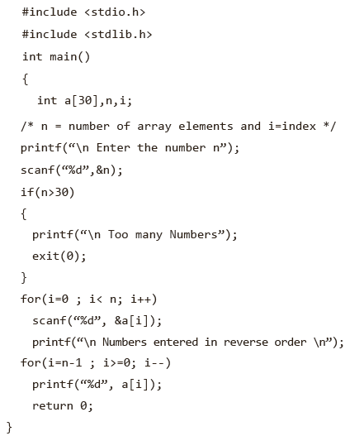

Slide 28
Print odd numbers in an array
#include <stdio.h>
int main()
{
int a[5],i;
printf("Enter 5 Numbers:\n");
/*For accepting 5-integer numbers from user*/
for(i=0;i<5;i++)
scanf("%d",&a[i]);
printf("Odd Numbers in Array are:\n");
for(i=0;i<5;i++)
{
if(a[i]%2!=0) //Check number is odd
{
printf("%d ",a[i]);
}
}
return 0;
}

Slide 29
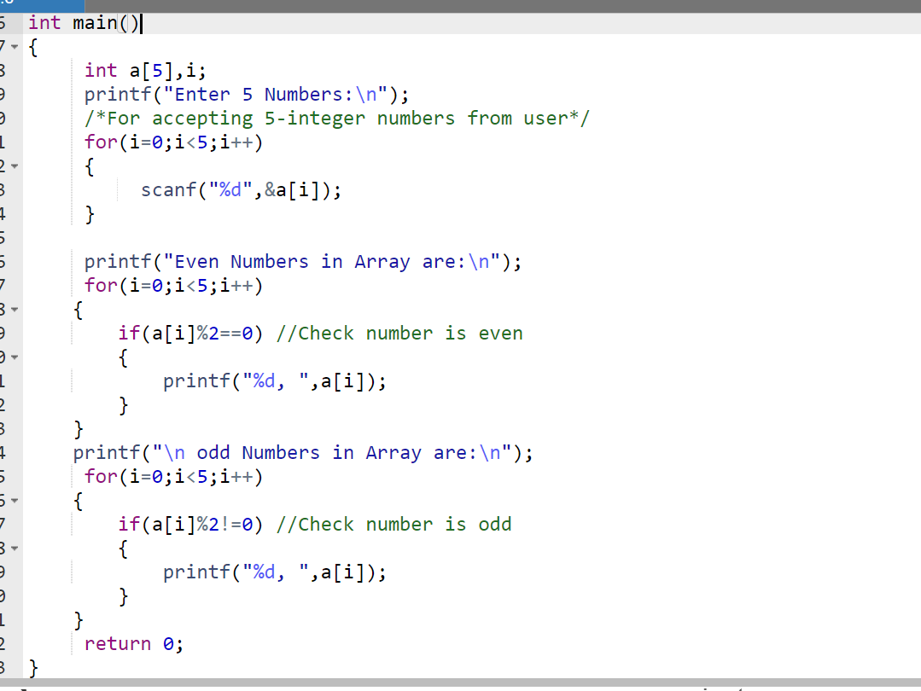

Slide 30
Write a program to find largest element stored in an array.

Slide 31
#include <stdio.h>
int main()
{
int a[50],i,n, large;
printf(“\nEnter how many numbers :”);
scanf(“%d”,&n);
printf(“\nEnter values for the array: ”);
for(i=0; i<n; i++) /* Stores number entered by user. */
scanf("%d",&a[i]);
/*code to find largest element in an array*/
large=a[0];
for(i=1; i<n; i++)
{
if(a[i]>large)
large=a[i];
}
printf(“\nThe largest element stored in array a is %d”, large);
return 0;
}
Now , you find out the min of an array

Slide 32
How to find second largest element in an array

Slide 33
Second largest array element in C
Max 1 = a[0]
Max 2 =0
if a[i] > Max1
Max2= Max1
Max 1=a[i]

Slide 34
Internal Representation of Arrays in C
References to elements outside of the array bounds It is important to realize that there is no array bound checking in C.
A bit of memory allocation It has been seen how arrays can be defined and manipulated. It is important to learn how to do this because in more advanced C programs it is necessary to deal with something known as dynamic memory management.
It is given a small area of the computer’s memory to use. This memory, which is known as the stack, is used by variables in the program
int a = 10;
fl oat values[100];

Slide 35
#include <stdio.h>
int main() {
int array[10] = {101, 11, 3, 4, 50, 69, 7, 8, 9, 0};
int loop, largest, second;
if(array[0] > array[1])
{
largest = array[0];
second = array[1];
}
else
{
largest = array[1];
second = array[0];
}
for(loop = 2; loop < 10; loop++) {
if( largest < array[loop] ) {
second = largest;
largest = array[loop];
}
else if( second < array[loop] ) {
second = array[loop];
}
}
printf("Largest - %d \nSecond - %d \n", largest, second);
return 0;
}

Slide 36
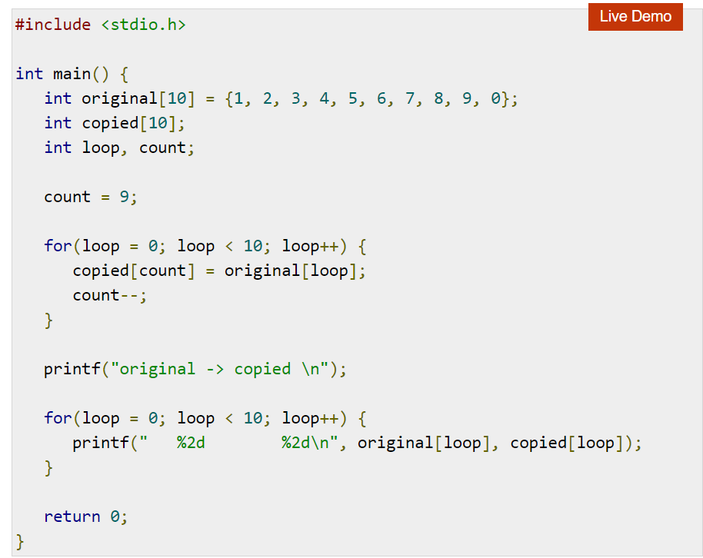

Slide 37
Variable Length Arrays and the C99 changes
With the earlier version of C(C89) compilers, an array’s size must be a constant integral expression so that it can be calculated at compile-time.
This has already been mentioned in earlier sections.
But in the C99 compilers, an array size can be an integral expression and not necessarily a constant one.
This allows the programmer to declare a variable-length array or an array whose size is determined at runtime.
In next slide ,the following program illustrates the concept:
Some changes in initializing an array has been made in C99.
In C99, initial values can be set only for certain elements, with uninitialized elements being initialized as 0.

Slide 38
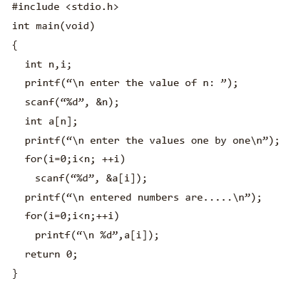
size is determined at runtime.

Slide 39
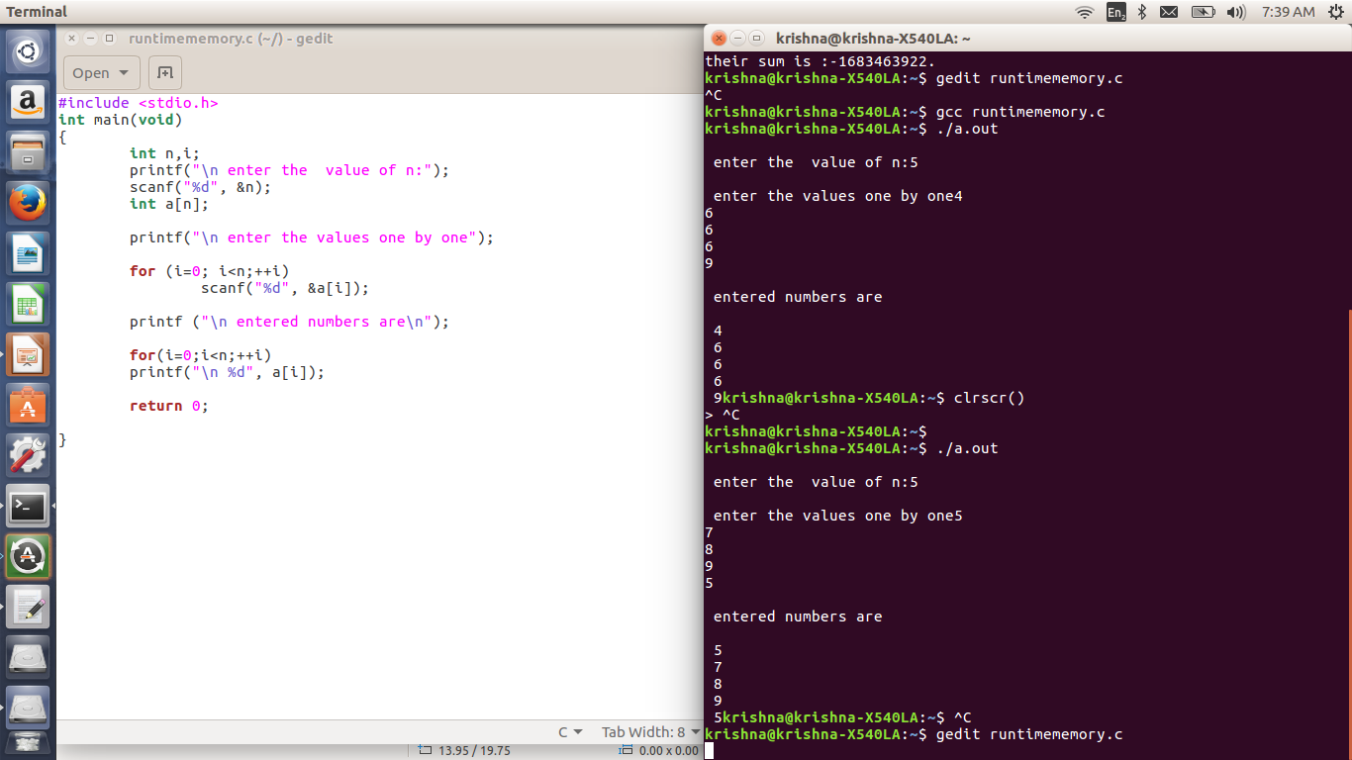

Slide 40
APPLICATION : One-Dimensional Array
Printing binary equivalent of a decimal number using array
Here the remainders of the integer division of a decimal number by 2 are stored as consecutive array elements.
The division procedure is repeated until the number becomes 0.

Slide 41
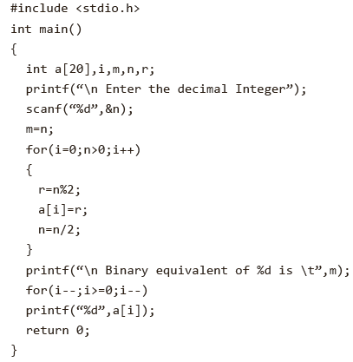

Slide 42
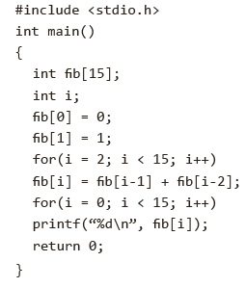

Fibonacci Series Using Array

Slide 43
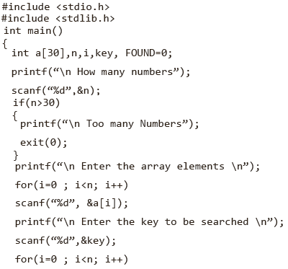
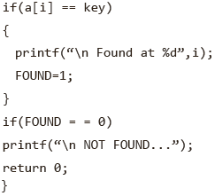
Searching an element within an array
For loop

Slide 44
Sorting an array

Slide 45
Bubble sort
A bubble sort compares adjacent array elements and exchanges their values if they are out of order.
Bubble sort is a simple sorting algorithm. This sorting algorithm is comparison-based algorithm in which each pair of adjacent elements is compared and the elements are swapped if they are not in order.
In this way, the smaller values ‘bubble’ to the top of the array (towards element 0), while the larger values sink to the bottom of the array.
This sort continues until no exchanges are performed in a pass.
This algorithm is not suitable for large data sets

Slide 46











After second iteration
After one iteration

Slide 47
algorithm
for all elements of list (outer for)
for each element in the list (inner for)
if list[i] > list[i+1]
swap(list[i], list[i+1])
end if
end for
End for
return list
Also , keep a swapped flag so that you know that there is no more swapping in the process. Array is sorted.

Slide 48
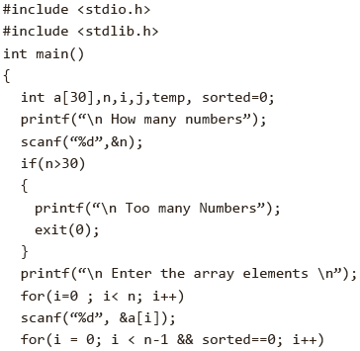
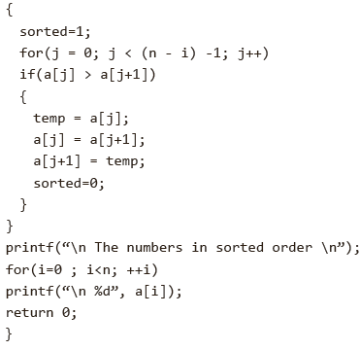
/*if no number was swapped that means array is sorted now (sorted =1, break the loop.*/
Bubble sort

Slide 49
Binary Search
This search algorithm works on the principle of divide and conquer. For this algorithm to work properly, the data collection should be in the sorted form.
Binary search looks for a particular item by comparing the middle most item of the collection. If a match occurs, then the index of item is returned.
If the middle item is greater than the item, then the item is searched in the sub-array to the left of the middle item.
Otherwise, the item is searched for in the sub-array to the right of the middle item. This process continues on the sub-array as well until the size of the subarray reduces to zero.

Slide 50

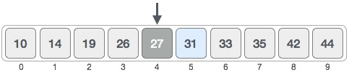

Binary search example
search the location of value 31
mid = low + (high - low) / 2
We find that the value at location 4 is 27. our number 31 is greater than 27.
Now we consider the right half of the array only.

Slide 51
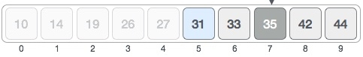

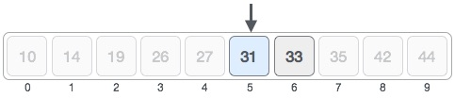
Binary search example contd.
Set new low and new mid
low = mid + 1
mid = low + (high - low) / 2
As mid number 35 is greater than 31, then the value must be in the lower part.
Hence, we calculate the mid again. This time it is 5. Match is found
We conclude that the target value 31 is stored at location 5.

Slide 52
Pseudocode
A ← sorted array
n ← size of array
x ← value to be searched
Set lowerBound = 1
Set upperBound = n
while x not found
if upperBound < lowerBound
EXIT: x does not exists.
set midPoint = lowerBound + ( upperBound - lowerBound ) / 2 if A[midPoint] < x
set lowerBound = midPoint + 1
if A[midPoint] > x
set upperBound = midPoint – 1
if A[midPoint] = x
EXIT: x found at location midPoint
end while

Slide 53
#include <stdio.h>
int main()
{ int c, first, last, middle, n, key, array[100];
printf("Enter number of elements\n");
scanf("%d",&n);
printf("Enter %d integers\n", n);
for (c = 0; c < n; c++)
scanf("%d",&array[c]);
printf("Enter value to find\n");
scanf("%d", &key);
first = 0;
last = n - 1;
middle = (first+last)/2;
while (first <= last)
{
if (array[middle] < key)
first = middle + 1;
else if(array[middle] == key)
{
printf("%d found at location %d.\n", key, middle+1);
break;
}
else
last = middle - 1;
middle = (first + last)/2;
}
if (first > last)
printf("Not found! %d is not present in the list.\n", key);
return 0;
}

Slide 54
Note
Single operations, which involve entire arrays, are not permitted in C.
Neither can all elements of an array be set at once nor can one array be assigned to another.
For an array of length L and data type X, the compiler allocates L* sizeof (X) bytes of contiguous space in memory.
char = 1 byte; int = 2 bytes ; float = 4 bytes;
Note the arrays
char array_nr1[40]; 40*sizeof(char) = 40 bytes
int array_nr1[10]; 10*sizeof(int) = 20 bytes
int array_nr2[10]; 10*sizeof(int) = 20 bytes

Slide 55
STRINGS: ONE-DIMENSIONAL CHARACTER ARRAYS
Strings in C are represented by arrays of characters. The end of the string is marked with a special character.
In the ASCII character set, the null character value is 0.
The null or string-terminating character is represented by another character escape sequence, \0.
Strings are actually one-dimensional array of characters terminated by a null character '\0'. Thus a null-terminated string contains the characters that comprise the string followed by a null.

Slide 56
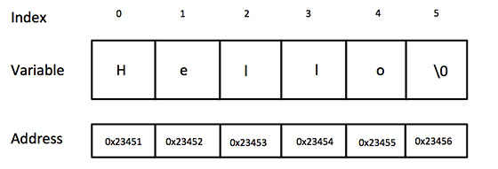
Declaration of A String
char greeting[6] = {'H', 'e', 'l', 'l', 'o', '\0'};
The C compiler automatically places the '\0' at the end of the string when it initializes the array
char test[100] = "Null terminator will follow me";
sprintf(test,"Null terminator will follow me");

Slide 57
Declaration of A String
Strings can be declared like one-dimensional arrays.
For example, char str[30]; char text[80];
An array formed by characters is a string in C.
The end of the string is marked with a the null character.
When the character array size is explicitly specified and the number of initializers completely fills the array size, the null character is not automatically appended to the array.

Slide 58
Printing Strings
The conversion type ‘s’ may be used for output of strings using printf().
The following points should be noted.
When the field width is less than the length of the string, the entire string is printed.
The integer value on the right side of the decimal point specifies the number of characters to be printed.
When the number of characters to be printed is specified as zero, nothing is printed.
The minus sign in the specification causes the string to be printed as left justified.

Slide 59
Example
#include <stdio.h>
int main()
{
char s[]=“Hello, World”;
printf(“>>%s<<\n”,s);
printf(“>>%20s<<\n”,s);
printf(“>>%-20s<<\n”,s);
printf(“>>%.4s<<\n”,s);
printf(“>>%-20.4s<<\n”,s);
printf(“>>%20.4s<<\n”,s);
return 0;
}
producing the output
>>Hello, World<<
>> Hello, World<<
>>Hello, World <<
>>Hell<<
>>Hell<<
>> Hell<<

Slide 60
String INPUT/OUTPUT
One special case, where the null character is not automatically appended to the array, is when the array size is explicitly specified and the number of initializers completely fills the array size.
char nonterminated[5] = "12345“;
printf() with the width and precision modifiers in the %s conversion specifier may be used to display a string.
The %s format does not require the ampersand before the string name in scanf().

Slide 61
String INPUT/OUTPUT
If fewer input characters are provided, scanf() hangs until it gets enough input characters.
scanf() only recognizes a sequence of characters delimited by white space characters as an external string.
The library function sprintf() is similar to printf().
The C library function sprintf () is used to store formatted data as a string.
You can also say the sprintf () function is used to create strings as output using formatted data.
The only difference is that the formatted output is written to a memory area rather than directly to a standard output.

Slide 62
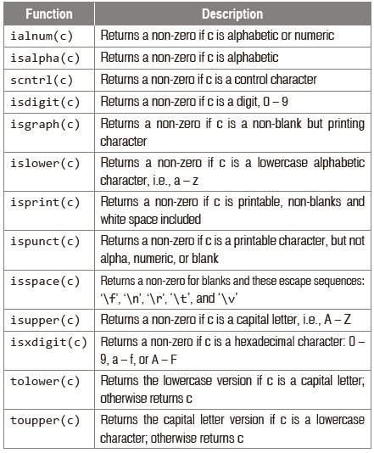
Character Manipulation in the String

Slide 63
isupper()
#include <stdio.h>
#include <ctype.h>
int main()
{ int var1 = 'M';
int var2 = 'm';
if( isupper(var1) )
{
printf("var1 = |%c| is uppercase character\n", var1 );
}
else
{
printf("var1 = |%c| is not uppercase character\n", var1 );
}
return 0;
}

Slide 64
toupper()
#include <stdio.h>
#include <ctype.h>
int main()
{ char c; c = 'm';
printf("%c -> %c", c, toupper(c));
/*Displays the same argument passed if other characters than lowercase character is passed to toupper()*/.
c = 'D';
printf("\n%c -> %c", c, toupper(c));
c = '9';
printf("\n%c -> %c", c, toupper(c));
return 0;
}
m -> M
D -> D
9 -> 9

Slide 65
fscanf & fprintf
fprintf(FILE *stream, const char *format, ...) sends formatted output to a stream.
fprintf(fp, "%s %s %s %d", "We", "are", "in", 2012); fclose(fp); return(0); }
fscanf(FILE *stream, const char *format, ...) reads formatted input from a stream.
fscanf(fp, "%s %s %s %d", str1, str2, str3, &year);

Slide 66
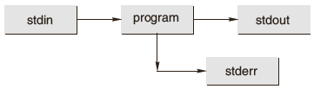
String input and output using fscanf() and fprintf()
stdin, stdout, and stderr: Each C program has three I/O streams.
The input stream is called standard-input (stdin); the output stream is called standard-output (stdout); and the side stream of output characters for errors is called standard error (stderr).
Now one might think that calls to fprinf() and fscanf() differ significantly from calls to printf() and scanf().
fprintf() sends formatted output to a stream and fscanf() scans and formats input from a stream.

Slide 67
Standard input and output
Standard File | File Pointer | What is happening
Standard input | stdin | Standard input is stream data (often text) going into a program (data transfers by use of the read operation)
Standard output | stdout | Standard output is the stream where a program writes its output data(data transfer with the write operation)
Standard error | stderr | Another output stream typically used by programs to output error messages. It is a stream independent of standard output and can be redirected separately

Slide 68
See the following example
#include <stdio.h>
int main()
{
int first, second;
fprintf(stdout,“Enter two inputs in this line: ”);
fscanf(stdin,“%d %d”, &first, &second);
fprintf(stdout,“Their sum is: %d.\n”, first + second);
return 0;
}

Slide 69
String Manipulation
C has the weakest character string capability of any general-purpose programming language.
Strictly speaking, there are no character strings in C, just arrays of single characters that are really small integers.
If s1 and s2 are such ‘strings’ a program cannot
Assign one to the other: s1 = s2;
Compare them for collating sequence: s1 < s2;
Concatenate them to form a single longer string: s1 + s2;
Return a string as the result of a function.

Slide 70
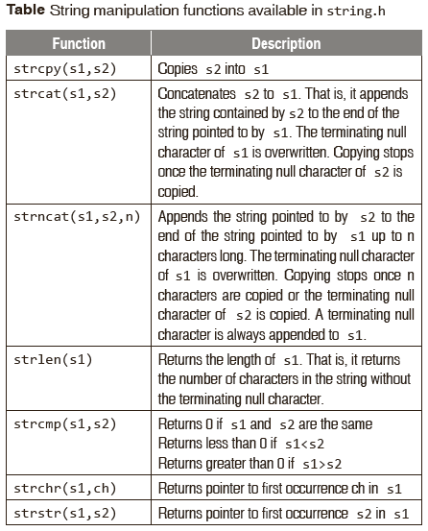
String Manipulation

Slide 71
Copying a String into another
Since C never lets entire arrays to be assigned, the strcpy() function can be used to copy one string to another.
strcpy() copies the string pointed to by the second parameter into the space pointed to by the first parameter.
The entire string, including the terminating NUL, is copied and there is no check that the space indicated by the first parameter is big enough.
The given code shows the use of the strcpy(str1, str2) function.
#include <string.h>
char s1[] =“Hello, world!”;
char s2[20];
strcpy(s2, s1);
puts (s2);

Slide 72
strcpy()
#include <stdio.h>
#include <string.h>
int main()
{
char str1[15];
char str2[15];
strcpy(str1, “Finally");
strcpy(str2, “Mid-sem is over !");
puts(str1);
puts(str2);
return(0);
}
Finally
Mid-sem is over!

Slide 73
Enter your Name and Print
#include <stdio.h>
int main()
{
char str[50];
printf("Enter a string : ");
//Option 1 to print string
scanf("%[^\n]s",str);
printf("You entered: %s", str);
//option 2 to print string
//gets(str);
//puts(str);
return(0);
}

Slide 74
puts() and gets()
The C library function puts(str) writes a string to stdout up to but not including the null character.
A newline character is appended to the output.
The C library function
gets (str) reads a line from stdin and stores it into the string.
It stops when either the newline character is read or when the end-of-file is reached, whichever comes first.
#include <stdio.h>
int main()
{
char str[50];
printf("Enter a string : ");
gets(str);
printf("You entered: %s", str);
return(0);
}

Slide 75
Comparing strings
strcmp() takes the start addresses of two strings as parameters and returns the value zero if the strings are equal.
declaration
int strcmp(char *str1, char *str2)
if Return value < 0 then it indicates str1 is less than str2.
if Return value > 0 then it indicates str2 is less than str1.
if Return value = 0 then it indicates str1 is equal to str2.
Each character is compared in turn an a decision is made as to whether the first or second string is greater, based on that character (ASCII value).
Only if the characters are identical do you move to the next character and, if all the characters were identical, zero is returned.

Slide 76
#include <stdio.h>
#include <string.h>
int main ()
{
char str1[15];
char str2[15];
int ret;
strcpy(str1, "abcdef");
strcpy(str2, "ABCDEF");
ret = strcmp(str1, str2);
if(ret < 0)
{
printf("str1 is less than str2");
}
else if(ret > 0)
{
printf("str2 is less than str1");
}
else
{
printf("str1 is equal to str2");
}
return(0);
}
strcmp()
str2 is less than str1
//strcmp will give a positive number if the first string is greater

Slide 77
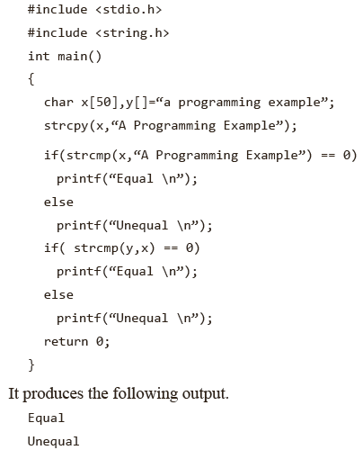
The following program illustrates the comparison of two strings:

Slide 78
Comparing strings
Since C never lets entire arrays to be assigned, the strcpy() function can be used to copy one string to another.
Strings can be compared by the help of strcmp() function.
The arithmetic addition cannot be applied for joining two or more strings; this can be done by using the standard library function, strcat().

Slide 79
Putting strings together strcat()
char strcat(dest, src)
Parameters
dest -- This is (pointer to) the destination array, which should contain a C string, and should be large enough to contain the concatenated resulting string.
src -- This is the string to be appended. This should not overlap the destination.
This function returns (a pointer to the) resulting string dest.

Slide 80
#include <stdio.h>
int main()
{
char string1[20];
char string2[20];
strcpy(string1, “Welcome");
strcpy(string2, “ToPCclass");
printf("Returned String : %s\n", strcat( string1, string2 )); printf("Concatenated String : %s\n", string1 );
return 0;
}
String concatenation
Returned String : WelcomeToPCclass
Concatenated String : WelcomeToPCclass

Slide 81
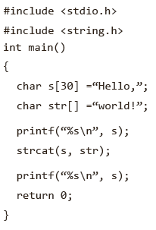
Putting strings together strcat()
The arithmetic addition cannot be applied for joining of two or more strings in the manner
string1 = string2 + string3; or
string1 = string2 +”RAJA”;
For this, the standard library function, strcat(), that concatenates strings is needed. It does not concatenate two strings together and give a third, new string.
In this example, the first call to printf prints “Hello,”, and the second one prints “Hello, world!”, indicating that the contents of str have been appended to the end of s.

Slide 82
Programs on strings
WAP to find the reverse of a string by using library function for reverse operation.
WAP to replace all occurrences of a character in a given string with a new character.

Slide 83
PROGRAM CODE
#include<stdio.h>
#include<string.h>
int main()
{
char s[100]; revs[100]
printf("\nEnter a string : ");
gets(s);
revs = strrev(s);
printf("\nThe reverse of the string is %s ", revs)
return 0 ;
}
Reverse a string
RUN-1
Enter a String : I am good.
The reverse of the string is .doog ma I
RUN-1
Enter a String : How are you?
The reverse of the string is
?uoy era woH

Slide 84
PROGRAM CODE
#include<stdio.h>
#include<string.h>
int main()
{
char s[100];
int l, i;
printf("\nEnter a string : ");
gets(s);
l=strlen(s);
printf("\nThe reverse of the string is ");
for(i=l-1; i>=0; i--)
printf(“%c”, s[i]);
return 0;
}
Reverse a string – without library function
INPUT/ OUTPUT
RUN-1
Enter a String : I am good.
The reverse of the string is .doog ma I
RUN-1
Enter a String : How are you?
The reverse of the string is
?uoy era woH

Slide 85
PROGRAM CODE
#include<stdio.h>
#include<string.h>
int main()
{
char s[100], och, nch;
int i, flag=0;
printf(“\nEnter a string :”);
gets(s);
printf(“\nEnter a character :”);
scanf(“%c”, &och);
printf(“\nEnter the new character :”);
scanf(“ %c”, &nch)//add a space
for(i=0; s[i]!=’\0’; i++)
{
if(s[i]==och)
{
s[i]=nch;
flag=1;
}
}//for loop ends here
Replace a char
INPUT/OUTPUT
RUN-1
Enter a string: Bachelor of Engineering
Enter a character: e
Enter a new character: A
After the replacement by new character, the string is BachAlor of EnginAAring
if(flag==1)
printf("\nAfter the replacement by new character, the string is %s”, s;);
else
printf("\nThe given string does not contain the character %c”, och);
return 0;
}

Slide 87
Multidimensional Arrays
Arrays with more than one dimension are called multidimensional arrays.
An array of two dimensions can be declared as follows:
data_type array_name[size1][size2];
Here, data_type is the name of some type of data, such as int. Also, size1 and size2 are the sizes of the array’s first and second dimensions, respectively.
A three-dimensional array, such as a cube, can be declared as follows:
data_type array_name[size1][size2][size3]

Slide 88
Two dimensional Array
Computer memory is essentially one dimensional with memory location running straight from 0 to highest.
A multidimensional array cannot be stored in memory as grid.
In computer, this array will be stored as below
1 | 2 | 3
4 | 5 | 6
7 | 8 | 9
Row 0
Row 1
Row 2
1 | 2 | 3 | 4 | 5 | 6 | 7 | 8 | 9
Row 0 |  |  | Row 1 |  |  | Row 2

Slide 90
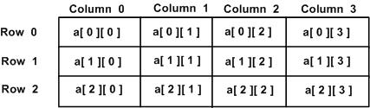
Two dimensional array
A two-dimensional array can be considered as a table which will have x number of rows and y number of columns.
Thus, every element in the array a is identified by an element name of the form a[ i ][ j ], where 'a' is the name of the array, and 'i' and 'j' are the subscripts that uniquely identify each element in 'a'.

Slide 91
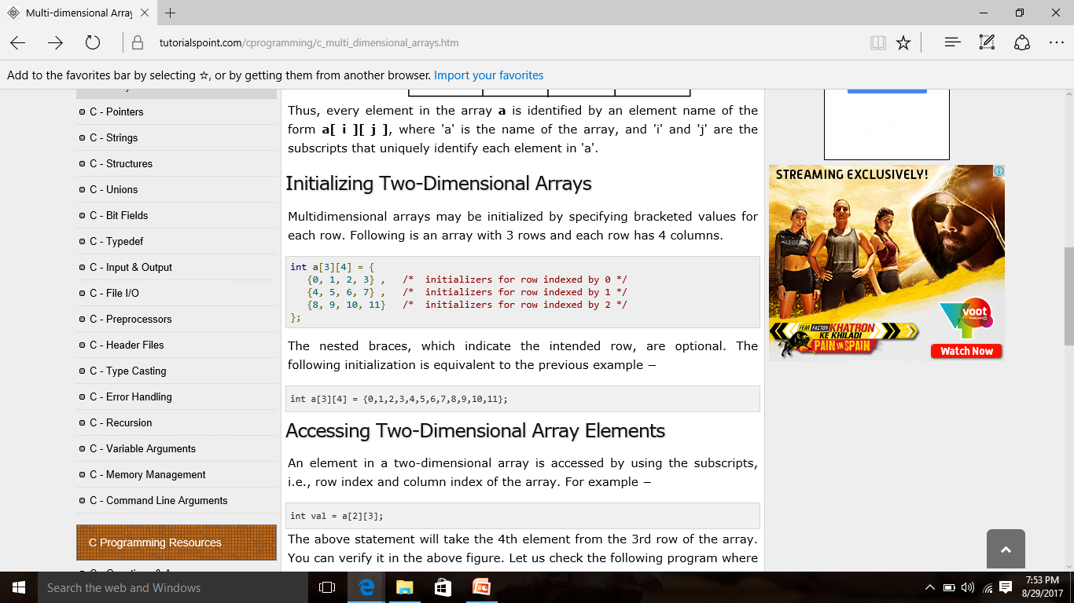

Slide 92
#include <stdio.h>
int main ()
{
/* an array with 5 rows and 2 columns*/
int a[5][2] = { {0,0}, {1,2}, {2,4}, {3,6},{4,8}};
int i, j;
/* output each array element's value */
for ( i = 0; i < 5; i++ ) // for rows
{
for ( j = 0; j < 2; j++ ) //for columns
{
printf("a[%d][%d] = %d\n", i,j, a[i][j] );
}
}
return 0;
} }
Accessing Two-Dimensional Array Elements
a[0][0]: 0
a[0][1]: 0
a[1][0]: 1
a[1][1]: 2
a[2][0]: 2
a[2][1]: 4
a[3][0]: 3
a[3][1]: 6
a[4][0]: 4
a[4][1]: 8
0 | 0
1 | 2
2 | 4
3 | 6
4 | 8

Slide 93
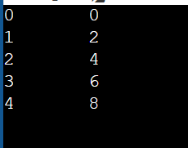
Matrix form printing
#include <stdio.h>
int main ()
{
/* an array with 5 rows and 2 columns*/
int a[5][2] = { {0,0}, {1,2}, {2,4}, {3,6},{4,8}};
int i, j;
/* output each array element's value */
for ( i = 0; i < 5; i++ ) // for rows
{
for ( j = 0; j < 2; j++ ) //for columns
{
printf("%d", a[i][j] );
printf("\t");
}
printf("\n");
}
return 0;
}

Slide 94
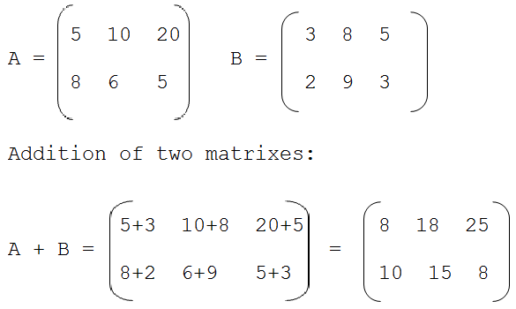












Matrix - Addition

Slide 95
sum of two matrices of order 2*2
#include <stdio.h>
int main()
{
float a[2][2], b[2][2], c[2][2];
int i, j;
// Taking input using nested for loop
printf("Enter elements of 1st matrix\n");
for(i=0; i<2; ++i)
for(j=0; j<2; ++j)
{
printf("Enter a%d%d: ", i+1, j+1); scanf("%f", &a[i][j]);
}
// Taking input using nested for loop printf("Enter elements of 2nd matrix\n"); for(i=0; i<2; ++i)
for(j=0; j<2; ++j)
{
printf("Enter b%d%d: ", i+1, j+1); scanf("%f", &b[i][j]);
}
// adding corresponding elements of two arrays
for(i=0; i<2; ++i)
for(j=0; j<2; ++j)
{
c[i][j] = a[i][j] + b[i][j];
}
// Displaying the sum printf("\nSum Of Matrix:"); for(i=0; i<2; ++i)
for(j=0; j<2; ++j)
{
printf("%.1f\t", c[i][j]); if(j==1)
printf("\n"); } return 0;
}

Slide 96
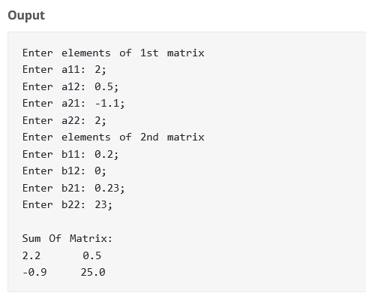

Slide 97
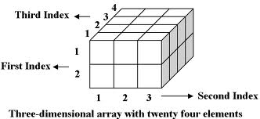
3 D Arrays

Slide 98
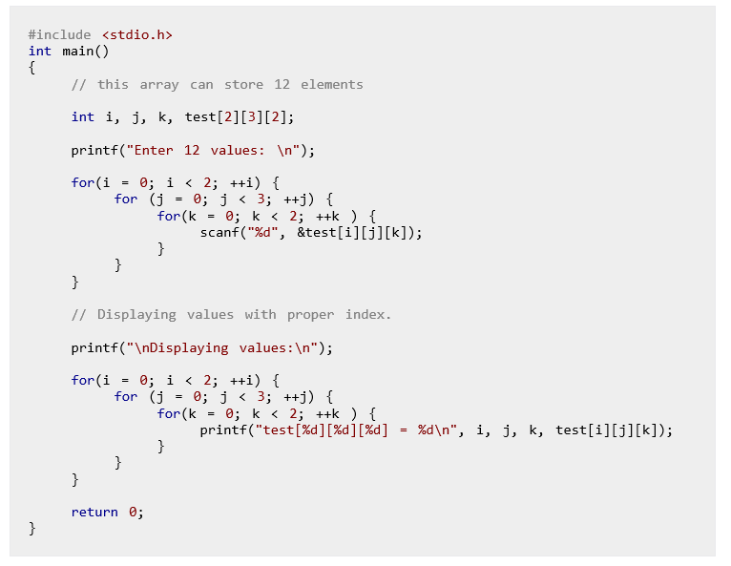
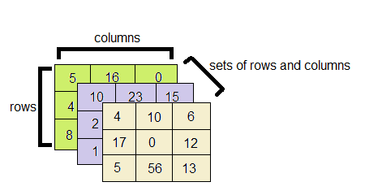


Slide 99
Multidimensional Arrays
Unsized Array Initializations
C compiler automatically creates an array big enough to hold all the initializers. This is called an unsized array.
The following are examples of declarations with initialization.
char e1[] =“read error\n”;
char e2[] =“write error\n”;

Slide 100
Multidimensional Arrays
Multi-dimensional arrays are kept in computer memory as a linear sequence of variables.
The elements of a multi-dimensional array are stored contiguously in a block of computer memory.
The number of subscripts determines the dimensionality of an array.
The separation of initial values into rows in the declaration statement is not necessary.
If unsized arrays are declared, the C compiler automatically creates an array big enough to hold all the initializers.

Slide 101
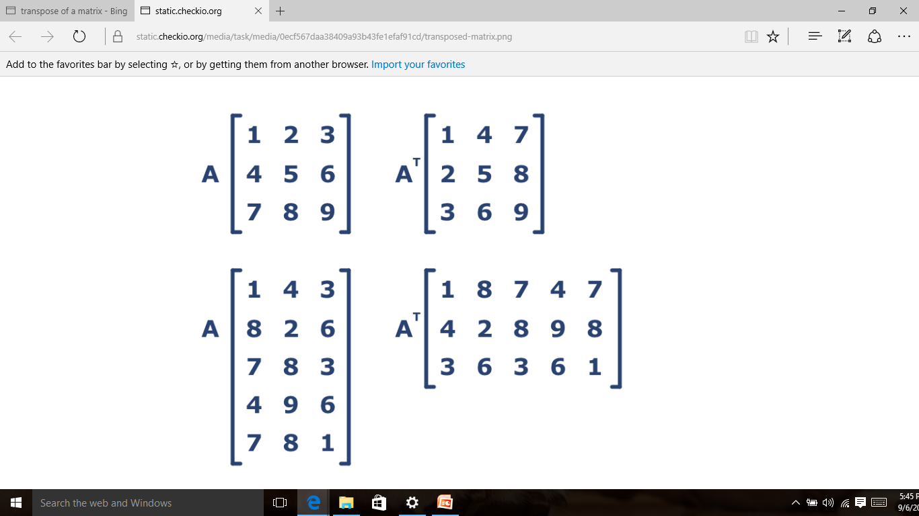
Transpose of a matrix

Slide 102
#include <stdio.h>
void main()
{
static int array[10][10];
int i, j, m, n;
printf("Enter the order of the matrix \n");
scanf("%d %d", &m, &n);
printf("Enter the coefficients of the matrix\n");
for (i = 0; i < m; ++i)
{
for (j = 0; j < n; ++j)
{
scanf("%d", &array[i][j]);
}
}
printf("The given matrix is \n");
for (i = 0; i < m; ++i)
{
for (j = 0; j < n; ++j)
{
printf(" %d", array[i][j]);
}
printf("\n");}
printf("Transpose of matrix is \n");
for (j = 0; j < n; ++j)
{
for (i = 0; i < m; ++i)
{
printf(" %d", array[i][j]);
}
printf("\n");
}
}
Enter the order of the matrix 3 3
Enter the coefficients of the matrix
3 7 9
2 7 5
6 3 4
The given matrix is
3 7 9
2 7 5
6 3 4
Transpose of matrix is
3 2 6
7 7 3
9 5 4

Slide 103
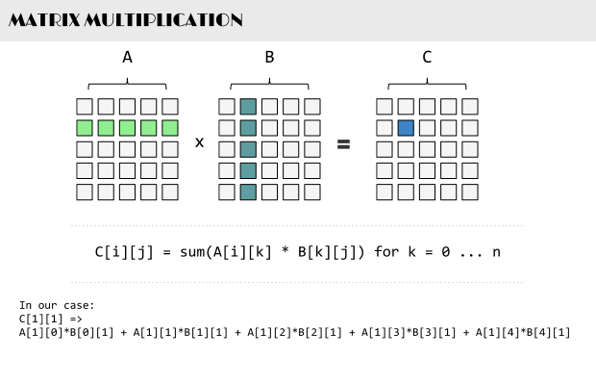








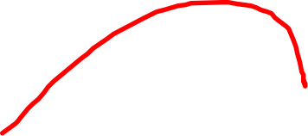










Multiplication matrix

Slide 104
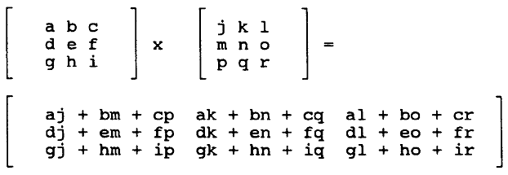
for(i=0;i<m;i++)
{
for(j=0;j<q;j++)
{
c[i][j]=0;
for(k=0;k<n;k++)
{
c[i][j]+=a[i][k]*b[k][j];
}
}
}

Slide 105




PROGRAM CODE
#include<stdio.h>
int main()
{
int a[10][10],b[10][10],c[10][10];
int i,j,k,m,n,p,q;
clrscr();
printf("\nThe row & column of Matrix A :");
scanf("%d%d",&m,&n);
fflush(stdin);
printf("\nThe row & column of Matrix B :");
scanf("%d%d",&p,&q);
if (n==p)
{
printf("\nFor Matrix A:-\n");
for(i=0;i<m;i++)
{
for(j=0;j<n;j++)
{
printf("\nEnter values for A[%d][%d]=> ",i,j);
scanf("%d",&a[i][j]);
}
}
Multiplication of two matrix
read
Read
First matrix

Slide 106
printf("\nFor Matrix B:-\n");
for(i=0;i<p;i++)
{
for(j=0;j<q;j++)
{
printf("\nEnter values for B[%d][%d]=> ",i,j);
scanf("%d",&b[i][j]);
}
}
//Matrix Multiplication Logic
for(i=0;i<m;i++)
{
for(j=0;j<q;j++)
{
c[i][j]=0;
for(k=0;k<n;k++)
{
c[i][j]+=a[i][k]*b[k][j];
}
}
}
is\n");
Read
Second matrix
Multiplication logic

Slide 107
printf("\nMatrix A is\n");
for(i=0;i<m;i++)
{
for(j=0;j<n;j++)
printf("%d\t",a[i][j]);
printf("\n");
}
printf("\n");
printf("\nMatrix B is\n");
for(i=0;i<p;i++)
{
for(j=0;j<q;j++)
printf("%d\t",b[i][j]);
printf("\n");
}
printf("\n");
printf("\nMultiplication Matrix C is\n");
for(i=0;i<m;i++)
{
for(j=0;j<q;j++)
printf("%d\t",c[i][j]);
printf("\n”);
}});
}
Print 1st Matrix
Print 2nd matrix
Print result matrix
else
printf("\nMultiplication is not possible.\n");
return 0;
}

Slide 108
Arrays of Strings: Two-dimensional Character Array
A two-dimensional array of strings can be declared as follows:
<data_type> <string_array_name>[<row_size>] [<columns_size>];
Consider the following example on declaration of a two-dimensional array of strings.
char s[5][30];

Slide 109
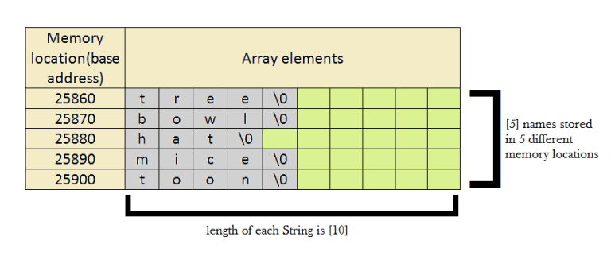
2 D char array
char name[5][10]={
"tree",
"bowl",
"hat",
"mice",
"toon"
};
The areas marked in green shows the memory locations that are reserved for the array but are not used by the string. Each character occupies 1 byte of storage from the memory.

Slide 110
Initialization
Two-dimensional string arrays can be initialized as shown
char s[5][10] ={“Cow”,”Goat”,”Ram”,”Dog”,”Cat”};
which is equivalent to
s[0] C o w \0
S[1] G o a t \0
S[2] R a m \0
S[3] D o g \0
S[4] C a t \0
Here every row is a string. That is, s[i] is a string. Note that the following declarations are invalid.
char s[5][] ={“Cow”,“Goat”,“Ram”,”Dog”,“Cat”};
char s[][] ={“Cow”,“Goat”,“Ram”,“Dog”,“Cat”};

